Slide 1

INFM 600: Information Environments
Week 9 - Wed Nov 16 & Thurs Nov 17, 2016:
Data to Information Workflows
Dr. Andrea Wiggins | Jonathan Brier

Slide 2
Definitions
Workflow: a sequence of operations, an abstraction of actual work
Workflow management system: information system that defines and manages a series of tasks to produce an outcome
Scientific workflow: “a specialized form of a workflow management system designed specifically to compose and execute a series of computational or data manipulation steps, or a workflow, in a scientific application.” (http://en.wikipedia.org/wiki/Scientific_workflow_system )

Slide 3
Rationale for Workflows
Permits agents to program their own analysis
Allows real-time execution, monitoring, and viewing
Built-in data retrieval and analysis tools
Simplifies sharing and reuse
Provenance for results
Notes:
Prompt students to describe the

Slide 4
Reasons to build workflows
Provenance management
Direct access to data sources
Combines technologies
Configurable for grids
Built-in data analysis tools
Other reasons you can think of?

Slide 5
Limitations
Lack of interoperability among WFMs
Lack of Support for interoperability among HAD systems or among WFMS and HAD systems
Inadequate performance for some business processes
Lack of support for correctness and reliability
Weak tool support for analysis, testing ,and debugging workflows.
(Georgakopoulos, M. Hornick, and A. Sheth 1995)
Notes:
What are the differences between workflows and business processes?
How are workflows related to business processes (see p122 of the reading diagram for reinforcement) -
-Business processes inform workflows.

Slide 6
Examples of Workflows
Provide an example of a workflow you have experienced in your work or outside work?
What did you like or dislike about the workflows?
Notes:
Talk about the process analysis with the registration system.
Prompt the students to think of the workflow that is invovled with student registration.
student registration database
class registration database
finance
With the class diagram the system as a workflow.

Slide 7
WFMS List from Wikipedia
Activiti
Apache ODE
Apache Taverna
Bonita BPM
CEITON
Comindware
Collective Knowledge
Cuneiform (programming language)
IBM BPM
Imixs-Workflow
Intuit QuickBase^{[6]}
jBPM
Kissflow
PRPC
Pyrus
Salesforce.com Process Workflow
SAP Business Workflow
Tallyfy
TACTIC (web framework)
Windows Workflow Foundation
Workgroups DaVinci
WorkflowGen
YAWL
Source: https://en.wikipedia.org/wiki/Workflow_management_system#List_of_WfMSa November 16, 2016
Notes:
What workflow management software have you worked with from this list?
What additional software have you used?
Does anyone think they haven’t used workflow managment software before? Note after responses that RStudio is a workflow managmeent system.

Slide 8
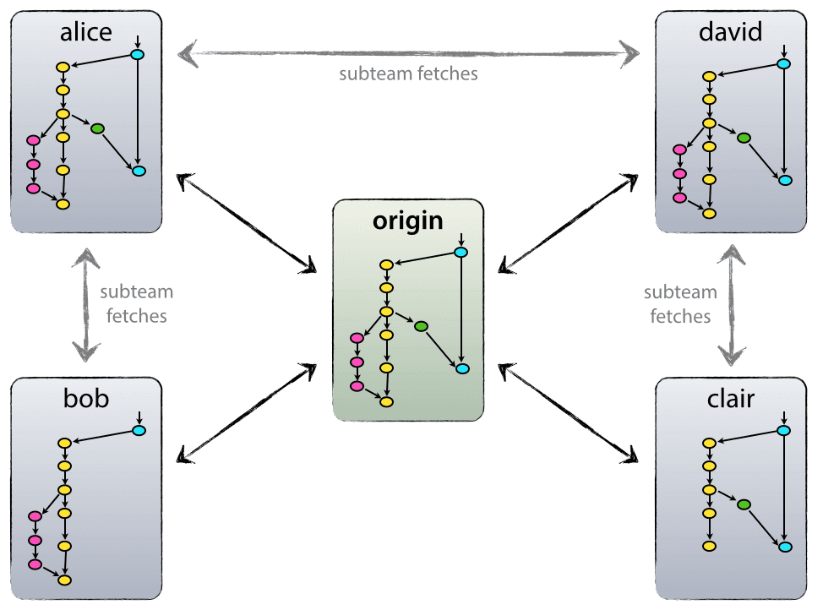
Workflow (this look familiar?)
Img source: http://nvie.com/posts/a-successful-git-branching-model/
Notes:
https://www.atlassian.com/git/tutorials/comparing-workflows/gitflow-workflow/
Remind them they saw this at the beginning of class. Ask about the diagram now they used git and if they can see the workflow in this diagram.
Talk about its representation then show the following slides breakdown of the different compoentents.

Slide 9
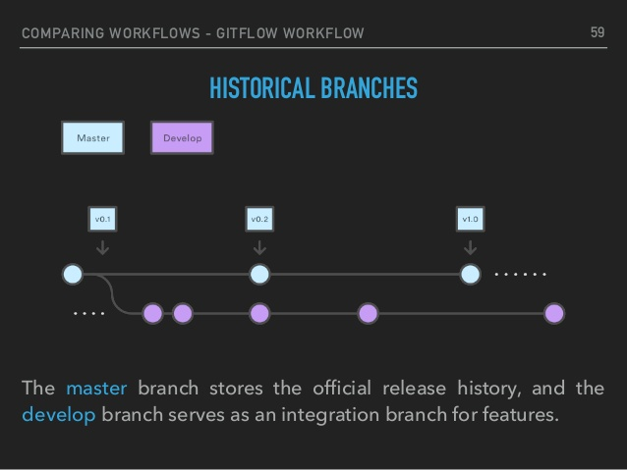
Git Workflows
CC-A: Majid Hajiloo, http://www.slideshare.net/hajiloo/git-61461563

Slide 10
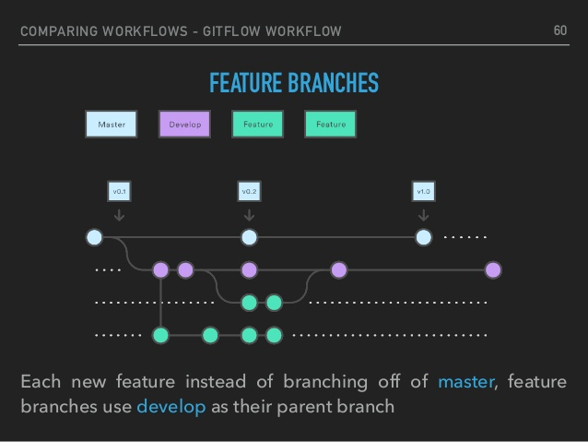
Git Workflows
CC-A: Majid Hajiloo, http://www.slideshare.net/hajiloo/git-61461563

Slide 11
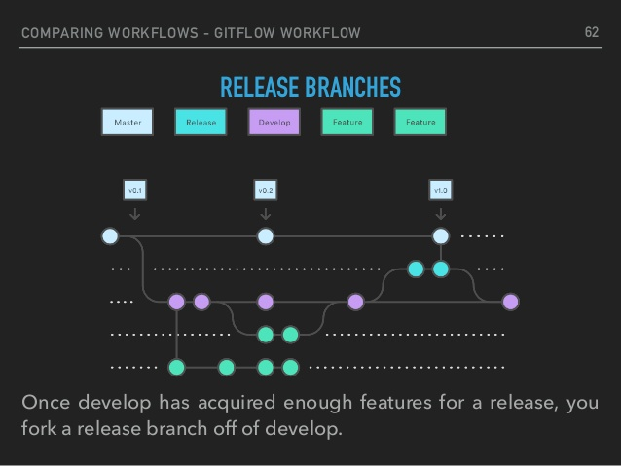
Git Workflows
CC-A: Majid Hajiloo, http://www.slideshare.net/hajiloo/git-61461563

Slide 12
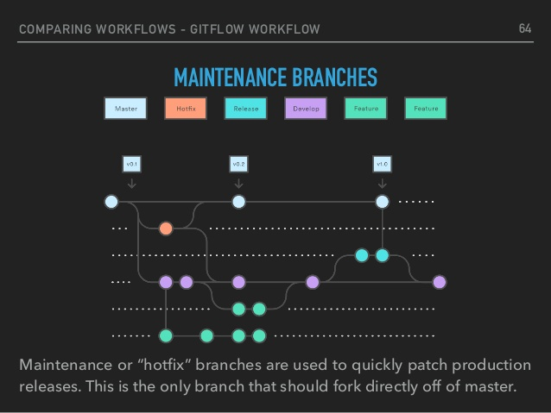
Git Workflows
CC-A: Majid Hajiloo, http://www.slideshare.net/hajiloo/git-61461563

Slide 13
Activity: Discussion in groups
When are automated workflows most useful?
Where is human in the loop important in workflows?
What analysis would let you run a workflow more efficiently?
How do workflows fit into the research/work environments you’ve encountered?
Under what circumstances would you recommend using a workflow tool?
What resources do you think you would need to support the use of the workflows?
What challenges do you foresee in modifying and implementing workflows?
Notes:
15-20 min group talk - 10 minute bring together
groups of 3

Slide 14

Break
Notes:
Breakdance Image is public domain - https://pixabay.com/en/breakdance-breaking-b-boying-bzw-310988/

Slide 15
RStudio Workflows
RStudio Projects
Git integration
R Notebooks - (.Rmd files)
knit - aka the way you produce the HTML and PDF output files
Notes:
http://rmarkdown.rstudio.com/lesson-10.html

Slide 16
Activity - Follow Along
Follow Along RStudio markdown files
Notes:
This will likely take 5 minutes
Demo:
creating rmd
integrate into github
integrating code
http://rmarkdown.rstudio.com/lesson-3.html
http://rmarkdown.rstudio.com/r_notebooks.html

Slide 17
What can you do with R markdown
Write a Book
Write a page
Create a presentation
Interactive dashboards and documents
More at http://rmarkdown.rstudio.com/gallery.html

Slide 18
Additional Reading (optional)
R based books on data science written in R Markdown
https://bookdown.org/
Gallery of other R based markdown productions
http://rmarkdown.rstudio.com/gallery.html
Reference Guide for R Markdown
https://www.rstudio.com/wp-content/uploads/2015/03/rmarkdown-reference.pdf (found on http://rmarkdown.rstudio.com/lesson-3.html)
Notes:
http://rmarkdown.rstudio.com/gallery.html
https://bookdown.org/

Slide 19
Remainder of Class
Create a notebook
Plot any two types of plots from the Whalers dataset & comment what it shows.
Display the script for the first plot and hide the script for the second plot.
Raise your hand to notify us to come and check it out.
THEN Team project work time:
With your datasets and scripts begin converting your plot and rscript to a single markdown document.
Suggestion use Git integration with Rstudio to integrate with your repo.
Dr Wiggins and I are here to answer questions.
Notes:
20-30 minutes at the end

